Slide 1
Project Purpose
Support the marketing analyst team at Cyclistic to design a new marketing strategy to convert casual riders into annual members.
Annual Subscribers
Single Pass Purchaser

Slide 2
Statement of the Business Task
Design marketing strategies aimed at converting casual riders into annual members.
In order to do that, however, the marketing analyst team needs to better understand how annual members and casual riders differ, why casual riders would buy a membership, and how digital media could affect their marketing tactics.

Slide 3
Description of Data Sources
We will be using Cyclistic’s historical trip data to analyze and identify trends.
We are going to use latest data between January to December 2021.
The data has been made available by Motivate International Inc. so it is reliable and can be trusted for the analysis.
Data is located on a server (https://divvy-tripdata.s3.amazonaws.com/index.html).

Slide 4
Supporting Visualizations and Key Findings
These are some important graphs & inferences from the analysis.

Slide 5
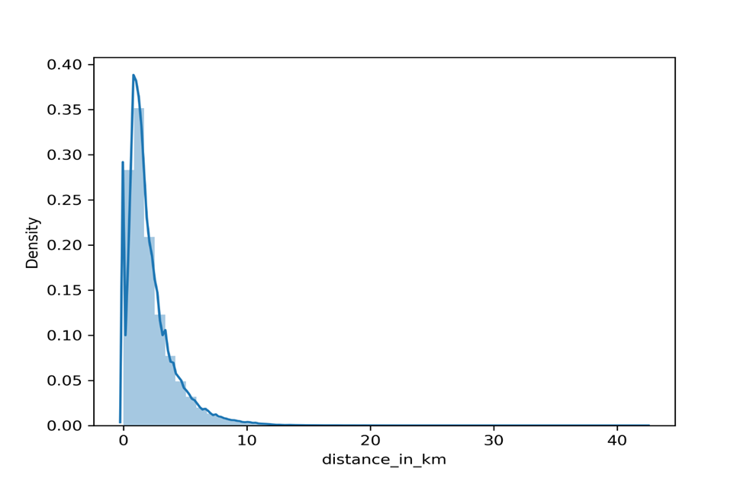
Analyzing trends of Average Distance Covered by Riders

Slide 6
Analyzing trends of casual and member types on each Day of Week

Slide 9
Analyzing trends of casual and member types on each Month of the Year

Slide 13
Analyzing trends of casual and member types on each Hour of Day

Slide 15
Analyzing trends of casual and member types in each Season

Slide 18
Analyzing trends of casual and member Riders Bike Preferences

Slide 21
Top Three Recommendations Based on My Analysis
Focus on the months when Casual Riders are much less than the annual members a the market is not saturated.
Focus on the bike preferences according to the season & take advantage of it.
Focus on the time spend and geo location tracking of the bike uses according to the start and end stations.

